Slide 1
Practical FHIR CIHI
Lloyd McKenzie
Mar. 13, 2018

Slide 2

Who am I?
Name: Lloyd McKenzie
Company: Gevity
Background:
One of FHIR’s 3 initial editors
Co-chair FMG, FHIR-I and MnM
HL7 Fellow
Heavily involved in HL7 and healthcare exchange for last 17 years (v2, v3, CDA, etc.)
lmckenzie@gevityinc.com

Slide 3
This presentation
Can be downloaded here:
https://github.com/FHIR/documents/blob/master/presentations/2018-03%20CIHI/Practical%20FHIR.pptx
Is licensed for use under the Creative Commons, specifically:
Creative Commons Attribution 3.0 Unported License
(Do with it as you wish, so long as you give credit)
Credit hereby given to James Agnew for most of the HAPI slides ☺

Slide 4
Attendees
How familiar are you with FHIR?
What is the one thing that will make today most valuable for you?

Slide 5
Tutorial Objectives
You should know
How to access and interpret the FHIR standard
How real-world “business concepts” map to FHIR resources and how those resources can be manipulated to support implementation projects
High level understanding of the Java reference libraries
Notes:
Have < 3 hours so focus is more on “identifying considerations” than deeply exploring options

Slide 6
Level Setting
Presumption is you already have an understanding of what FHIR is, how it’s different and why it matters
If not, check out the FHIR for Executives webinars
We won’t talk much about FHIR design considerations
Consider checking out FHIR for Architects

Slide 7
Agenda
Morning
Navigating the FHIR Spec
Understanding resources
Understanding profiles & conformance
RESTful FHIR
Afternoon
RESTful queries
Bundles
Java Reference Implementation

Slide 8
FHIR Resources

Slide 9
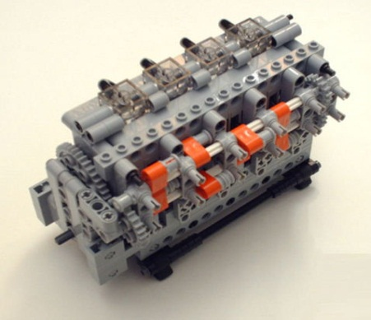
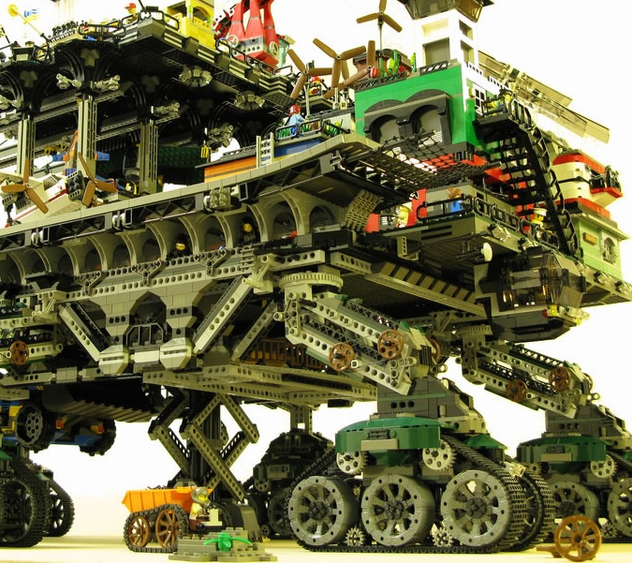

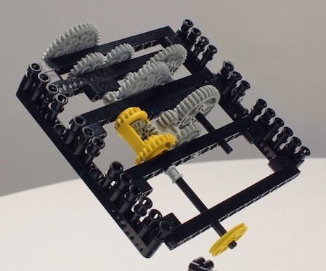
FHIR solutions
Resources
Extensions
Solution
+
=
Notes:
Resources are building blocks, but useful in their own right
Extensions supplement what resource doesn’t cover
Solutions can be simple or complex

Slide 10


Resources
“Resources” are:
Small logically discrete units of exchange
Defined behavior and meaning
Known identity / location
Smallest unit of transaction
“of interest” to healthcare
V2: Sort of like Segments
V3: Sort of like CMETs

Slide 11
What’s a Resource?
Examples
Non-examples
Administrative
Patient, Practitioner, Organization, Location, Coverage, Invoice
Clinical Concepts
Allergy, Condition, Family History, Care Plan
Infrastructure
Document, Message, Profile, Conformance
Gender
Too small
Electronic Health Record
Too big
Blood Pressure
Too specific
Intervention
Too broad
100-150 total - ever
Notes:
And few systems will ever see more than 40-50

Slide 12
Structure of a Resource
Resource
Narrative
Metadata
Elements
Extensions
Extensions

Slide 13
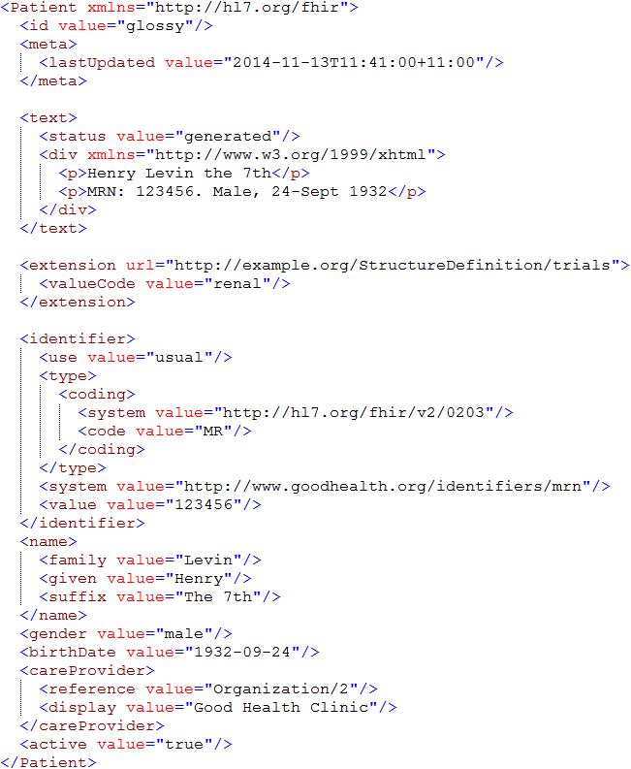
Identity & Metadata
Human Readable Summary
Extension with reference to its definition
Standard Data Content:
MRN
Name
Gender
Date of Birth
Provider

Slide 14
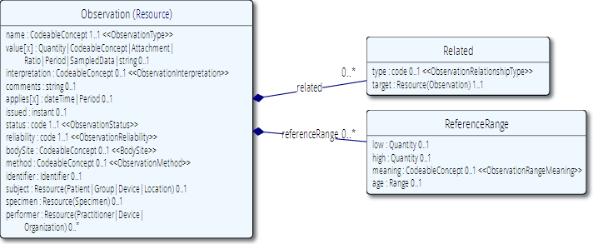
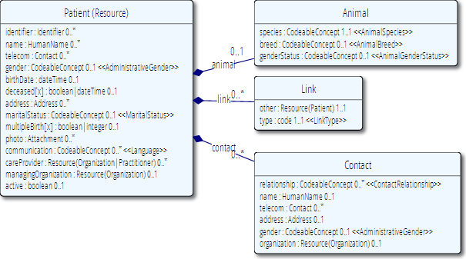
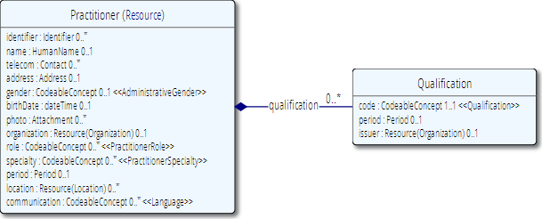
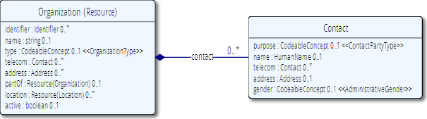
Network
subject
performer
organization

Slide 15
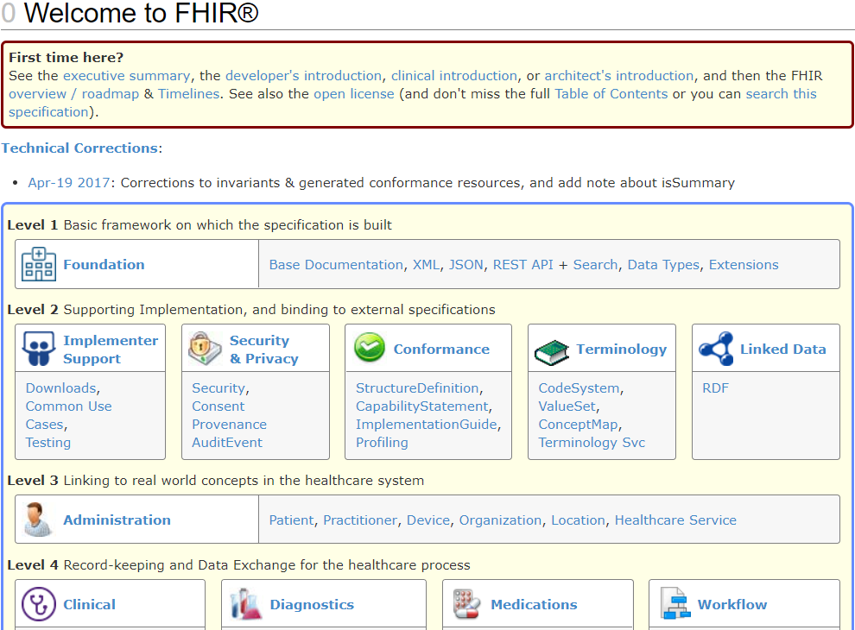
Browsing the site
Notes:
Jump to the spec. Jump around. Finish ~10am

Slide 16
Browsing the site
REST API
Data Types
XML & JSON
Codes / Terminologies
Resource List

Slide 17
The FHIR distribution
Under Implementation-Support-Downloads:
The XSD schema’s / schematrons
The Java / C# / Delphi zips (model, serializers, parsers, etc, both code & binary)
All xml + json examples
Full spec for offline reading (always have your FHIR with you)

Slide 18
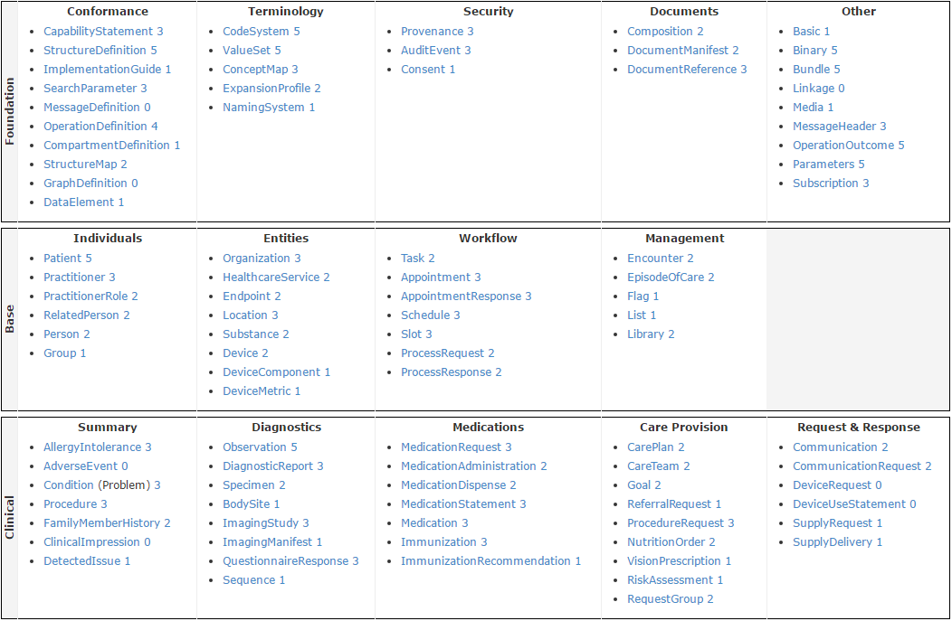
STU 3 Resource List

Slide 19
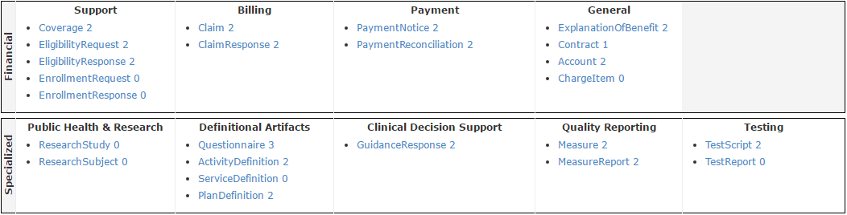
STU 3 Resource List

Slide 20
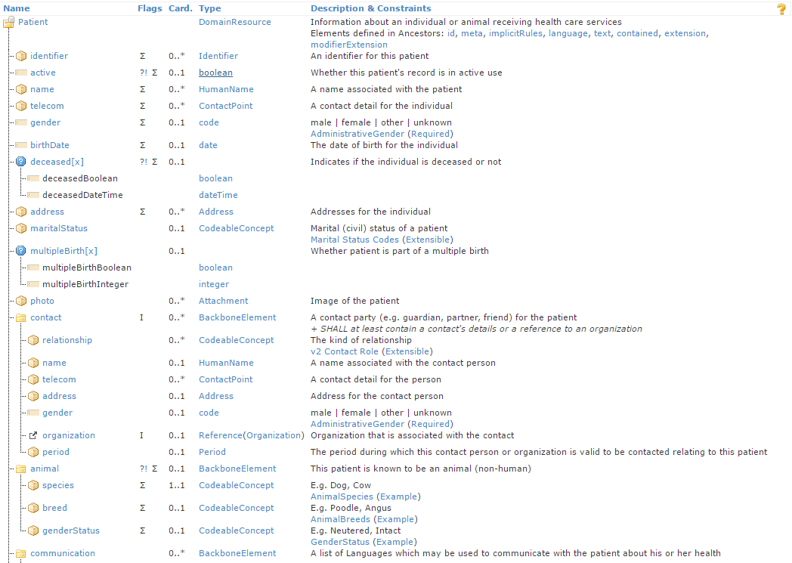
Resource Definitions

Slide 21
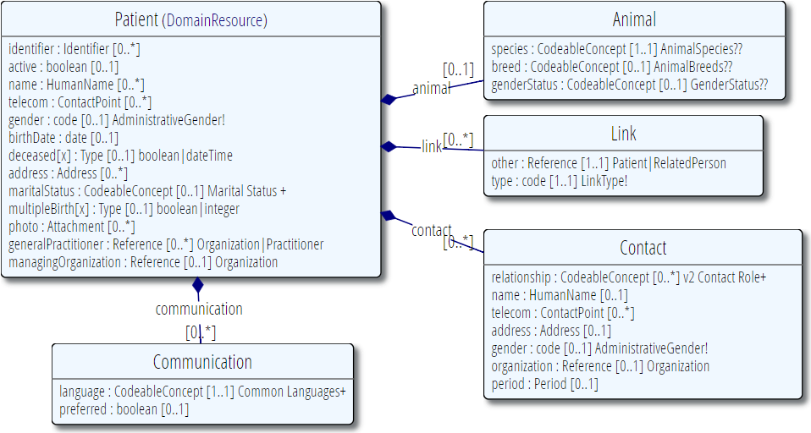
Resource Definitions

Slide 22
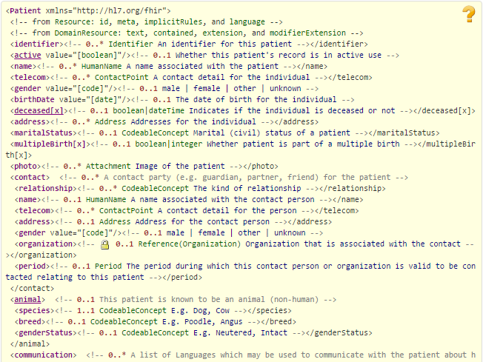
Resource Definitions

Slide 23
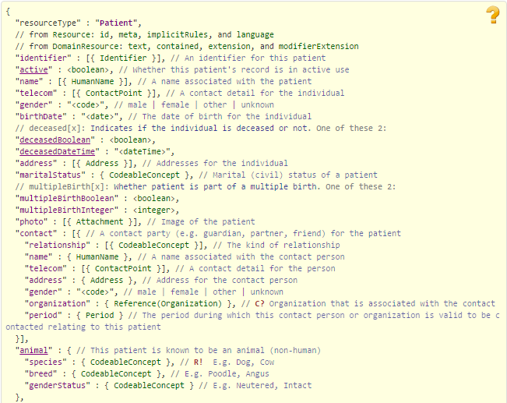
Resource Definitions

Slide 24
Exercise #1
What resource
would you use for:
(10 minutes)

Slide 25
What resource would you use for:
Blood Pressure
Dictated sound clip
Cheek swab
Laboratory
Home visit
Problem List
Audit record
Clinical Document
Contracted taxi driver
Record of narcotic use
Group smoking cessation workshop
Females over 35
Public Health Case Report
Notes:
Record individually, then discuss as a group

Slide 26
Profiles and Conformance

Slide 27
The need for Profiles
Many different contexts in healthcare, but a single set of Resources
Need to be able to describe restrictions based on use and context
Allow for these usage statements to:
Authored in a structured manner
Published in a repository
Used as the basis for validation, code, report and UI generation.

Slide 28
The need for Profiles
Profiles can serve the same purpose as:
CDA templates & implementation guides
HL7 v2 “static” profiles
CIMI implementation guides
OpenEHR Archetypes & templates
Profiles aren’t mandatory for interoperability, but they improve the degree of it.
Profiles never change meaning of an instance

Slide 29
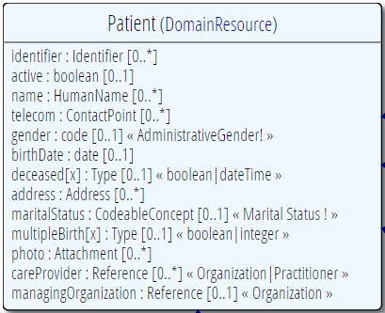
Profiling a resource
Demand that the identifier uses your national patient identifier
Limit names to just 1 (instead of 0..*)
Limit maritalStatus to another set of codes that extends the one from HL7 international
Add an extension to support “RaceCode”
Note: hardly any mandatory elements in the core spec!

Slide 30
Structured & published
A Profile is just a “normal” Resource
Any FHIR server could serve Profiles (just like Patients, Observations, etc…)
So, any FHIR server is a profile repository!
You can send a resource and the profile it conforms to in the same bundle
A resource is simply referred to by its URI:
e.g. https://hl7.org/fhir/Profile/iso-21090

Slide 31
Using profiles
When communicating a resource, you can indicate the profiles it conforms to.
A server might explicitly state it only accepts resources conforming to a certain profile (and verify!)
You can ask a FHIR server to validate a resource against a given profile
Notes:
Be cautious about relying on declared profiles – not all systems will declare, not all declarations will be right.

Slide 32
Extensions
Accommodate those elements not supported by 80% of systems
Note - You’re not extending a resource per se, but you specify where an extension may occur:
A specific element within a resource (even root)
A specific element within a data type
All elements referencing a data type
All elements mapping to a specific mapping target
An extension

Slide 33
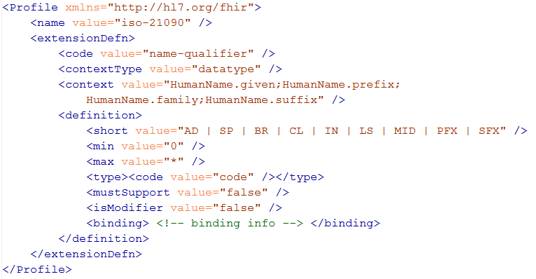
Extension definition
Note: multiple
contexts!

Slide 34
Must support?
Authors: SHALL be capable of providing a value for the element and resource
Consumers: SHALL be capable of extracting and doing something useful with the data element.
"Something useful" is context dependent. The Profile SHALL describe what it means for applications to “support” the element
Notes:
* Note: the spec *never* sets this to true, since it’s context dependent.

Slide 35
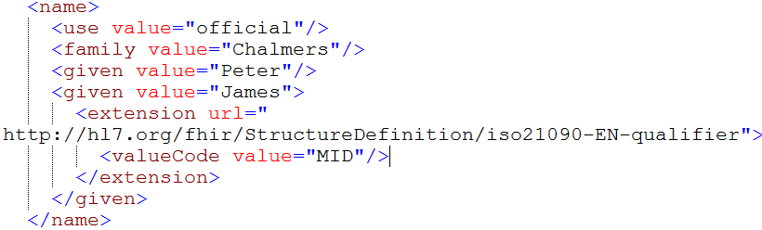
Extending a name
Key = location of formal definition
Value = value according to definition
Notes:
Extensions can show up anywhere – inside a Boolean, string, human assignment

Slide 36
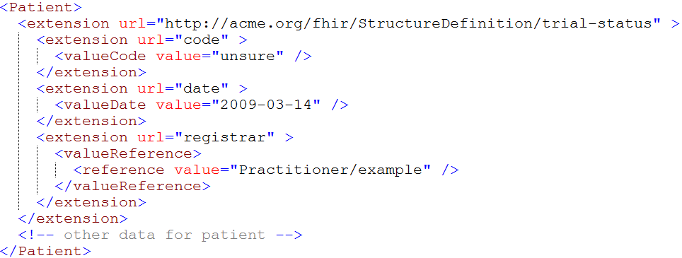
Extending an extension?

Slide 37
Constraining cardinality
Limit cardinality to 1..2
(e.g. to at maximum your organizations’ identifier + the national one)
1..2
1..1
0..0
Limit names to just 1 (instead of 0..*)
Forbid any telecom elements
Note: something that’s mandatory in the core definition cannot be made optional in a profile

Slide 38
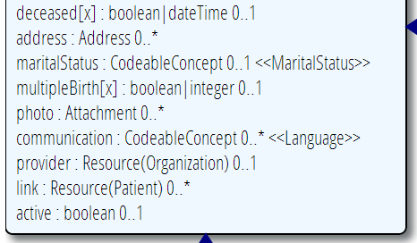
Limit value domains
If deceased is given, it must be a dateTime, not a boolean
AddressNL
Use a profiled datatype (from this or other profile)
OrganizationNL
=“true”
Only allow reference to a profiled resource
Only allow “active” Patients

Slide 39
Contextualize narrative
Override the base spec’s descriptions by adding context specific narrative:
short : string 1..1
formal : string 1..1
comments : string 0..1
requirements : string 0..1
synonym : string 0..*
example[x] : 0..1 (example value!)
mappings : 0..* (more specific mappings)

Slide 40
Profiling bindings
Depending on “core” spec, you can:
“fixed”: not specify a different binding
“incomplete”: specify a different binding if needed
“example”: very likely specify a different binding
Change the bindings as specified in core:
Define a new ValueSet
Allow additional codes, Restrict to a subset
Specify whether implementers of your profile can deviate from your valueset.

Slide 41
Conformance levels
Fixed: You must use this value set if you send the element.
If it’s a CodeableConcept, you can sent translations too
Extensible: You must use a code from this value set if one applies
Preferred: Recommend using this code system, but ok if you don’t
Example: No recommendation, may be incomplete

Slide 42
ValueSets
A “true” FHIR ValueSet resource (may be version specific)
A general reference to some web content that defines a set of codes. (e.g. mime types).
A textual description of the possible codes

Slide 43
Add formal constraints
Invariants, co-occurrence
Uses free text (human) + xpath (executable)
Constraints should be declared on lowest element in the hierarchy that is common to all nodes referenced by the constraint.
Identified by (local) id, involved elements refer to that id
Specify severity (“error” or “warning”)

Slide 44
Slicing
Slicing = constraining a repeating element
Base Composition has 0..* “Sections”
Section has 0..1 element with content
Schematic view of Composition (aka a Document header)
Composition
type: CodeableConcept
Section
code: CodeableConcept
content: Resource(Any) 0..1
0..*

Slide 45
Slicing into a CCD
“Slice” the repeating sections into a fixed set of profiled sections.
“code” is fixed and is called the discriminator
Composition
type = “34133-9” “Summarization of
episode note”
Section
code = 42348-3 (“Advance directives”)
Section
code =11450-4 (“Problem list”)
…
Section
code = 18776-5 (“Treatment plan”)

Slide 46
Profiles at run-time
In addition to design-time constraints, profiles can be used at run-time
Load a profile to guide user-entry to meet a particular best practice guideline
Validate against a profile to determine whether an instance meets certain requirements (e.g. for decision-support)
Adjust data entry rules on-the-fly to reflect the constraints of a specified server

Slide 47
Profile Tooling
Forge – free, .NET based, Beta-level tool
Supports most profiling requirements
Trifolia – similar to CDA profiling, not as intuitive as Forge
Spreadsheets – More capable than Forge or Trifolia, won’t be supported forever
Hand Edited – not for the faint of heart

Slide 48
Conformance
There’s a resource for documenting conformance to FHIR
Can be used for:
Stating how a specific system instance behaves
Defining how a software system is capable of behaving (including configuration options)
Identifying a desired set of behavior (e.g. RFP)
To declare themselves “FHIR Conformant”, a system must publish a Conformance instance

Slide 49
REST

Slide 50
REST
Simple, out-of-the-box interoperability
Leverage HTTP: GET, POST, etc.
Pre-defined operations
Create, Read, Update, Delete
Also: Read Version, Search (resource/type/server), History (resource/type/server), Capabilities, Patch, Batch & Transaction
Rest
Notes:
Review

Slide 51
FHIR Resource URLs
Template | Description | Example | Operations
[base] | Server URL | http://fhir.com | GET, POST
[base]/[type] | Collection Manager | http://fhir.com/Patient | GET, POST
[base]/[type]/[id] | URL for a resource | http://fhir.com/Patient /23 | GET, PUT, DELETE, PATCH
[base]/[type]/[id]/_history/[vid] | Past version | http://fhir.com/Patient/23/_history/2 | GET
[base]/([type]/([id]/)?)?$[name] | Operation (server action) | http://fhir.com/Patient /23/$everything | GET, POST
Notes:
URL (http://myhospital.org/) you are invoking in first column, and operations at right
OPTIONS - Return available HTTP methods and other options

Slide 52
When to use REST?
Want low coupling between systems
In theory, very little up-front negotiation required
Small, light-weight exchanges
Focus is CRUD operations
Also for publish/subscribe
Client-driven client-server orchestration
Server endpoint has fixed location
Well-suited for Mobile, PHR, Registries
Rest
Notes:
Not talking about REST in general, but rather FHIR’s implementation of REST

Slide 53
When to avoid REST?
Complex or server-driven orchestration
Order of operations matters (e.g. complex decision support)
Unit of work != resource
“Transaction” may be an option
No natural “server” or no fixed network location
Lack of trust in the client for contextual audit, etc.
Rest
Notes:
Todo: more specifics from Grahame.

Slide 54
Just a quick GET
GET /fhir/Patient/1 HTTP/1.1
HTTP/1.1 200 OK
Content-Type: application/xml+fhir;charset=utf-8
Content-Length: 787
Content-Location:
http://fhir.furore.com/fhir/Patient/1/_history/1
Last-Modified: Tue, 29 May 2012 23:45:32 GMT
HTTP Verb + path
UTF-8 encoded
<?xml version="1.0" encoding="UTF-8"?>
<Patient xmlns="http://hl7.org/fhir"><id value="1"/><meta><lastUpdated value="2012-05-29T23:45:32Z"/></meta><text><status value="generated"/><xhtml:div xmlns:xhtml= "http://www.w3.org/1999/xhtml">Everywoman, Eve. SSN:444222222</xhtml:div></text><identifier><type> <coding><system value="http://hl7.org/fhir/v2/0203"/><code value="SS"/></coding></type><system value="http://hl7.org/fhir/sid/us-ssn"/><value value="444222222"/></identifier><name><use value= "official"/><family value="Everywoman"/><given value="Eve"/></name><telecom><system value="phone"/> <value value="555-555-2003"/><use value="work"/></telecom><gender value="female" /><birthDate value="1973-05-31"/><address><use value="home"/><line value="2222 Home Street"/></address> <managingOrganization><reference value="Organization/hl7"/></managingOrganization><active value="true"/></Patient>
See the BOM?
Notes:
You can retrieve any person using a GET on the person’s id, which is just an url on the server: /fhir/person/@<id>
We have our own MIME-type: “text/xml+fhir”
Note that FHIR always uses UTF-8. Since this is not the default for HTTP, the server explicitly mentions this
But should mean the xml encoding mentions “utf-8” and that the payload is really encoded in utf-8
There can be a Byte Order Mark, but hopefully your framework handles all that ;-)
The response returns a Content-Location header with a version-specific location….see next slide

Slide 55
A Resource’s identity
In fact: a URL
https://server.org/fhir/Patient/1
resource type
endpoint
identifier
Note: This URL resolves to the current version of a resource
Notes:
This is not only the URL you use to retrieve the resource, it’s also its id.
All URLs in FHIR are case-sensitive (and so is the id)
It is *metadata*, you won’t find this in the Resource’s definition

Slide 56
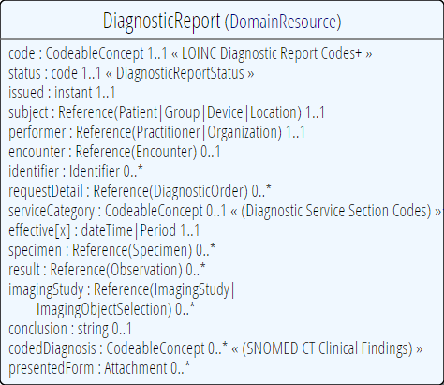
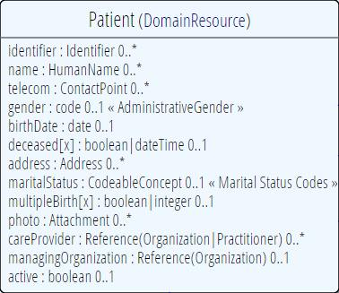
“Business” identifiers
Notes:
Resource Id’s (=URLs) are infrastructural id’s, they differ from “business” identifier.
Many Resources also have business identifiers, they are explicitly modeled, like Patient.identifier (even more than one identifier possible!)
Business identifiers are completely separate from technical resource id’s

Slide 57
One more look at the header
GET /fhir/Patient/1 HTTP/1.1
HTTP/1.1 200 OK
Content-Type: application/xml+fhir;charset=utf-8
Content-Length: 787
Etag: W/”12”
Content-Location: http://fhir.furore.com/fhir/Patient/1/_history/12
Last-Modified: Tue, 29 May 2012 23:45:32 GMT
Notes:
Etag is new in DSTU 2, preferred method to track version.
Weak etags only because tag is the same regardless of XML, JSON or RDF. Would be strong if linked directly to a representation

Slide 58
For a specific version…
We have the version-specific URL
https://server.org/fhir/ (continued)
Patient/1/_history/4
base path
resource type
identifier
version id
Notes:
Both the Resource id URL and the version-specific URL are used on many places of the REST spec and resource content (References!). They are always used consistently in this form.

Slide 59
Support for versions
33, v12 – 2012-12-04
/server.org/fhir/Patient/33/_history/12
33, v13 – 2012-12-05
/server.org/fhir/Patient/33/_history/13
33, v14 – 2012-12-08
/server.org/fhir/Patient/33/_history/14
33, v15 – 2012-12-09
/server.org/fhir/Patient/33/_history/15
/server.org/fhir/Patient/33
Notes:
* Note that you have two ways (at one moment) to reach version 15

Slide 60
REST “representations”
GET /fhir/Patient/1?_format=json HTTP/1.1
HTTP/1.1 200 OK
Content-Type: application/json+fhir;charset=utf-8
Content-Length: 787
GET /fhir/Patient/1 HTTP/1.1
Accept: application/json+fhir
HTTP/1.1 200 OK
Content-Type: application/json+fhir;charset=utf-8
Content-Length: 787
Notes:
For testing, very handy to use in url, also some langauges don’t allow to edit accept header
Preferred method is using accept header
----
You can retrieve any person using a GET on the person’s id, which is just an url on the server: /fhir/person/@<id>
We have our own MIME-type: “text/xml+fhir”
Note that FHIR always uses UTF-8. Since this is not the default for HTTP, the server explicitly mentions this
But should mean the xml encoding mentions “utf-8” and that the payload is really encoded in utf-8
There can be a Byte Order Mark, but hopefully your framework handles all that ;-)
The response returns a Content-Location header with a version-specific location….see next slide

Slide 61
Mapping (meta)data to HTTP
Resource data
Resource id
Resource version
Last update date
Tags
http body
Url
eTag
Last-Modified header
N/A (used to be category header)
Notes:
Should be ~2:30pm

Slide 62
To create a resource
You POST the contents to a url that indicates the resource type:
E.g. https://server.org/fhir/Patient
Supply body’s format in Content-Type header
Server returns 201 (Created).
Returns only the newly assigned version id URL in the Location header.
It may also return the full resource content
Notes:
There are ways in header to say I don’t want full content back, or I do want it back, but server can still decide

Slide 63
To update a resource
Use PUT on the resource’s URL, with the new contents in the body
Tell server the body’s format (xml/json) in the Content-Type header
Server returns 200 and the URL to new version in the Content-Location header.
It may also return the full resource content
Notes:
One reason you might want body back, is servers may not store everything you give them.
They might not trust you for address, so they don’t update.
Clients can’t force server to accept content

Slide 64
Using PUT to create
Server might/might not allow you to PUT to an id that does not yet exist.
If it does: Resource gets created at that location ➔ client determines resource’s id!
If it does not: server returns 501 (Not implemented)
Notes:
- Whether server allows this depends on the level of trust between server and client: e.g. in-house scenario versus nation-wide network.

Slide 65
Control over returned content
When responding to a create or update, server can return just headers or full body
Client can use “prefer” http header to indicate what it wants back:
Prefer: return=minimal
Prefer: return=representation
Notes:
Sometimes servers may not accept all data received, so returning full body can be useful
For low-bandwidth circumstances, may not want data, even if not everything has been applied

Slide 66
Conditional behavior
Read (GET)
If-Modified-Since: Sat, 02 Feb 2013 12:02:47 GMT
If-None-Match: W/”11”
Update (PUT)
If-Match: W/”11”
Create (POST)
If-None-Exist: http://somewhere.org/fhir/Patient? identifier=http://hl7.org/fhir/sid/us-ssn/| 123456789
Notes:
Maybe already have copy of resource, ask for only since date. Keeping versions for every resource change is important, not mandatory. Spec allows you to retrieve previous versions – show me version 12. Lots of systems that don’t have capacity to track versions, so you may make decision based on your back end.
Update if resource is version 11. Request will fail if no match
Create so long as no other patient has this ssn.

Slide 67
Collision-detecting updates
All update and query responses SHOULD return an eTag
Use If-Match on the update to check for collisions
Server will then return 409 (Conflict) if it has been updated by someone else in the meantime
Server can force inclusion of If-Match by returning 412 (Pre-condition failed status codes) if If-Match is missing
Notes:
Behaviour depends on server configuration (and made public in a conformance statement).

Slide 68
What’s a ‘deleted’ Resource?
Trying read operations will return in a 410 (Gone) result in stead of 404 (Not Found)
The resource will not be returned by the search operation.
You can “undelete” by doing an update with fresh content
Just a “marker” in a resource’s history
Notes:
* the deletion operation should be understood as deleting the record of the resource, with nothing about the state of the real-world corresponding resource implied.

Slide 69
Version history - deletions
33, v12 – 2012-12-04
/server.org/fhir/Patient/33/_history/12
33, v13 – 2012-12-05
/server.org/fhir/Patient/33/_history/13
33, v14 – 2012-12-08
/server.org/fhir/Patient/33/_history/14
33, v15 – 2012-12-09
/server.org/fhir/Patient/33/_history/15
33, v16 – 2012-12-10
DELETION
/server.org/fhir/Patient/33/_history/16
/server.org/fhir/Patient/33
Notes:
Now, if you query for /server.org/fhir/patient/@33, you get a 410
If you do a get on v15, you will get it

Slide 70
Version history - revival
33, v13 – 2012-12-05
/server.org/fhir/Patient/33/_history/13
33, v14 – 2012-12-08
/server.org/fhir/Patient/33/_history/14
33, v15 – 2012-12-09
/server.org/fhir/Patient/33/_history/15
33, v16 – 2012-12-10
/server.org/fhir/Patient/33/_history/16
33, v17 – 2012-12-11
/server.org/fhir/Patient/33/_history/17
/server.org/fhir/Patient/33
Notes:
The resource returns back to life!
Query on resource on and not found
Query for history, you would get all and find 15 is available
PUT – with your update to 15 and you can bring patient back to l ife

Slide 71
Exercise #3
Some RESTful exercise . . .
(15 minutes)

Slide 72
RESTful operations
Using your HTTP submission tool + the an example instance from the spec
Create the instance (using PUT or POST)
Update the instance
Delete the instance
Retrieve history
Notes:
How many Donald Ducks do we have now? – no constraint on duplicates unless you implement a business rule

Slide 73
Bundles

Slide 74
Communicating lists
We need to communicate lists of Resources
Search result
History
Documents or messages
Multiple-resource inserts (“transactions”)
Sometimes we need to communicate bundles of bundles
E.g. Search result or operation result returning documents

Slide 75
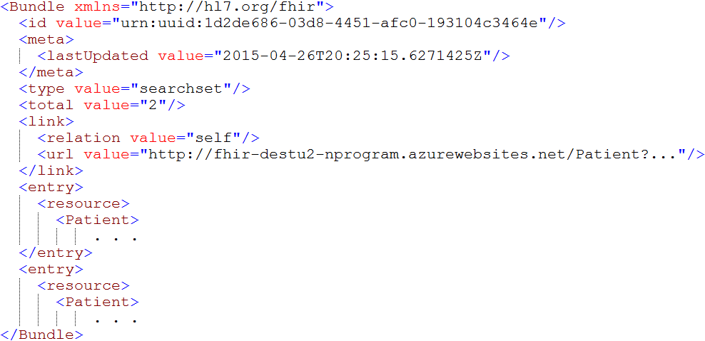
An example Bundle

Slide 76
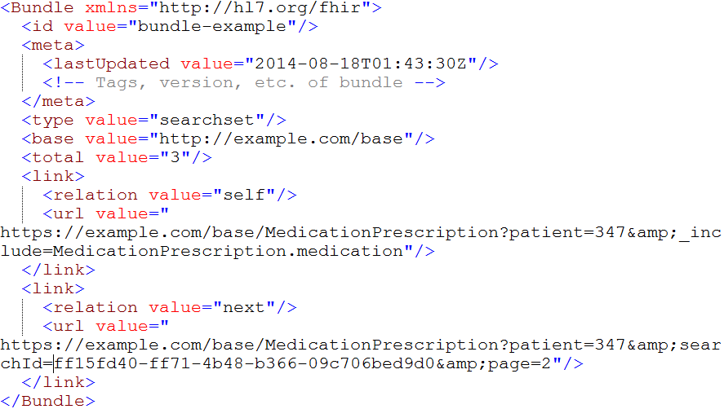
The bundle header
Notes:
Note that we use the ultra-new (sept 2012) Tombstones RFC, which is not yet supported by all platforms.
Remember, all updated timestamps in FHIR (type: ‘instant’) are precise to at least the second and ALLWAYS carry a timezone!

Slide 77
Bundle Types
Code | Description
document | Bundle is a document – rooted in Composition
message | Bundle is a message – rooted in MessageHeader
transaction | Process all entries as part of a single unit of work
transaction-response | Each entry represents the results on a 1-for-1 basis of an original transaction
history | A list of versions of a single resource
searchset | The results of a search
collection | A set of resources collected for ease of distribution
batch | A set of independent resources – to be processed individually
batch-response | The bundle is a batch response. Note that as a batch, some responses may indicate failure and others success.

Slide 78
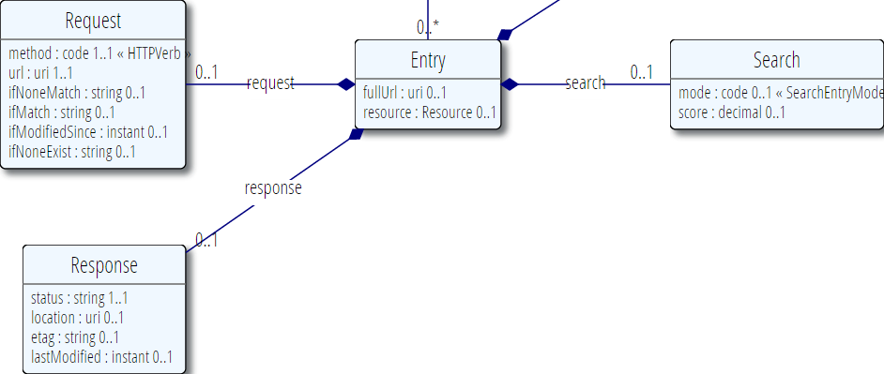
Bundle Entry

Slide 79
Bundle Entry
A resource (optional), plus a few other things:
Absolute link to the resource (including base)
Transaction header info
E.g. PUT vs. POST, ifNoneMatch, etc.
Transaction response header info
E.g. etags, lastModified, transaction status
Search info
Why is this entry included?
How good a match was it?

Slide 80
Example: Keeping in sync
History of all resources on server
https://server.org/fhir/_history
History of all patient resources on server
https://server.org/fhir/Patient/_history
History of specific patient on server
https://server.org/fhir/Patient/1/_history
A history of all changes: updates and deletions, ordered by newest first
Limit with _since and _count

Slide 81
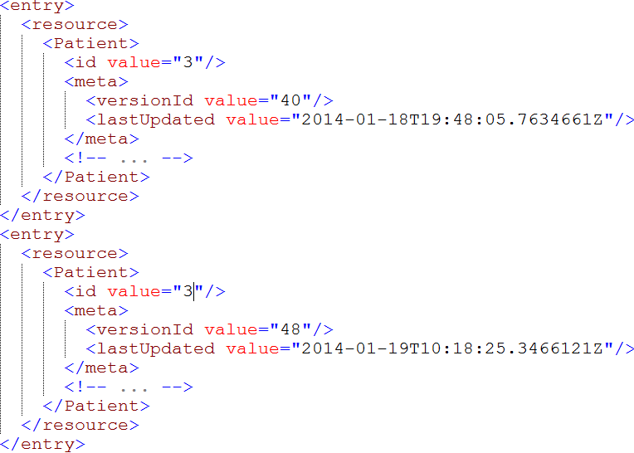
Multiple versions of entries
Same
id!
Notes:
Multiple versions are supported explicitly by Atom by having mutliple entries with the same id, but a different ‘updated’ date
Notice how the ‘self’ links do differ, these are different versions after all.

Slide 82
Identifiers in Bundles
Resources in a bundle will frequently need to reference each other
Absolute: https://example.org/fhir/Observation/1
Relative: Observation/1
(absolute will have a “:”, relative won’t)
Relative references must be made absolute using the base of the referencing resource
If resource absoluteURL = http://someserver/Patient/1
Then reference “Observation/3” corresponds to http://someserver/Observation/3
Notes:
Around 4pm

Slide 83
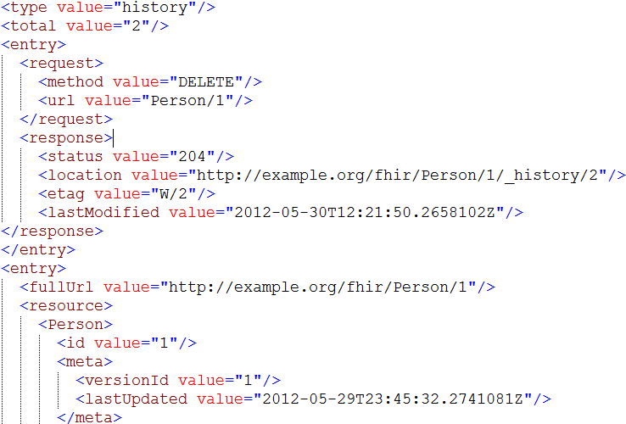
Deleted entries in History
Version & time of deletion

Slide 84
FHIR Documents
Characteristics
A point-in-time snapshot of information
Intended for persistence
Organize information for human consumption
Defined rules for how to render
Attested by a particular author
Do not (directly) drive behavior
May be clinical (e.g. CDA) or non-clinical (e.g. Structured Product Labeling)

Slide 85
Documents – are bundles
Composition Resource
<Bundle>
<entry>
<resource>
<Composition />
</resource>
</entry>
<entry>
<resource>
<Observation />
</resource>
</entry>
<entry>
<resource>
<Device />
</resource>
</entry>
<entry>
<resource>
<List/>
</resource>
</entry>
<entry>
<resource>
<Condition/>
<resource>
</entry>
</Bundle>
Metadata
Attester
Section
Section
Section
Observation Resource
Device Resource
List Resource
Condition Resource
Notes:
A Document, no matter how nested, is flattened to a list of entries, the Document’s header being the first.
The document header (and any other the other resources) refer to each other using normal references to reflect the document’s nesting.
Of course, there may be a digital signature (on the whole Bundle) to attest to the content of the document.

Slide 86
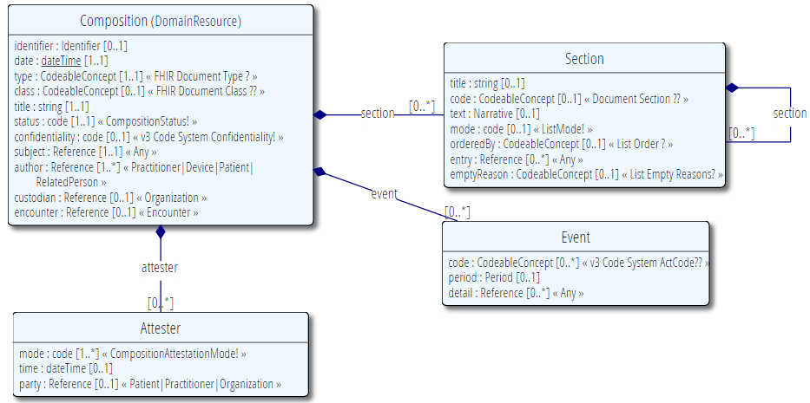
The Composition resource

Slide 87
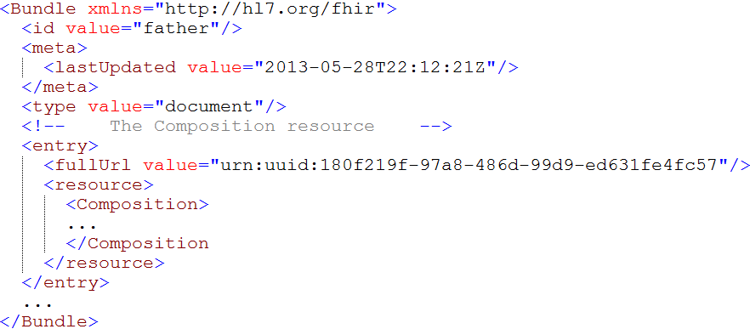
Tag as “Document”
This Bundle is a Document
Notes:
Why else might a bundle start with a Composition?

Slide 88
Communicating documents
You can store your document using
https://server.org/fhir/Bundle
Storage, NO disassembly is implied, document (and signature) stays intact
Search is supported (you search on it using Composition search criteria)
Notes:
* But of course, some server could have functions to disassemble documents on reception. Since the contents of documents are resources, each of the contained resources (including the Composition) can be stored using

Slide 89
Communicating documents (cont’d)
Documents can be passed around using the Binary resource
https://server.org/fhir/Binary
Storage, NO disassembly is implied, document (and signature) stays intact
Search is supported, but only by id
Useful for referencing a document as a resource

Slide 90
Communicating documents (cont’d)
Documents can be sent to a server’s “root” URI for processing as a transaction
https://server.org/fhir
Each resource is processed separately
Document id and signature is lost
Can theoretically re-assemble by retracing from the Composition resource
Notes:
http://hl7.org/fhir/documents.html#bundle

Slide 91
Communicating documents (cont’d)
You can pass a document as a parameter to an operation
Behavior depends on the definition of the operation, but could include workflow invocation, persistence, disassembly, generation of DocumentReference instances or combinations there-of

Slide 92
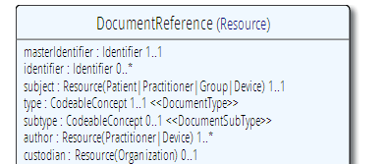
(XDS) references
A document reference resource is used to describe a document that is made available to a healthcare system.
DocumentReference and DocumentManifest Resources are used in document indexing systems, and are used to refer to:
CDA documents in FHIR systems
FHIR documents stored elsewhere (i.e. registry/repository following the XDS model)
PDF documents, and even digital records of faxes where sufficient information is available
Other kinds of documents, such as records of prescriptions.

Slide 93
IHE MHD
Mobile Health Documents
Offers equivalent functionality to IHE’s XDS specification but using a RESTful framework – implemented using FHIR
Allows centralized indexing and distributed storage of document-based content

Slide 94
FHIR Messages
Messages are collections of resources sent with the intention of driving some sort of action
often replied to with another message
Not intended for persistence as a whole
Always tied to some sort of “event”
Specific originator and intended recipient
Same as v2 and v3 message model
Notes:
Through extensions, you could have a ‘fan-out’ message that could be sent to multiple end points

Slide 95
Messages – are bundles
MessageHeader Resource
<Bundle>
<entry>
<resource>
<MessageHeader />
</resource>
</entry>
<entry>
<resource>
<Observation />
</resource>
</entry>
<entry>
<resource>
<Device />
</resource>
</entry>
<entry>
<resource>
<Patient/>
</resource>
</entry>
</Bundle>
source
destination
event
Observation Resource
Device Resource
Patient Resource
Notes:
A Message is similar, refers (amongst others) to its author, and contains information about the source, destination and the event that triggered it.
A message contains 1 “data” resource, which is the root of the payload of the message. This is just a normal resource, which in its turn can refer to other related resources.

Slide 96
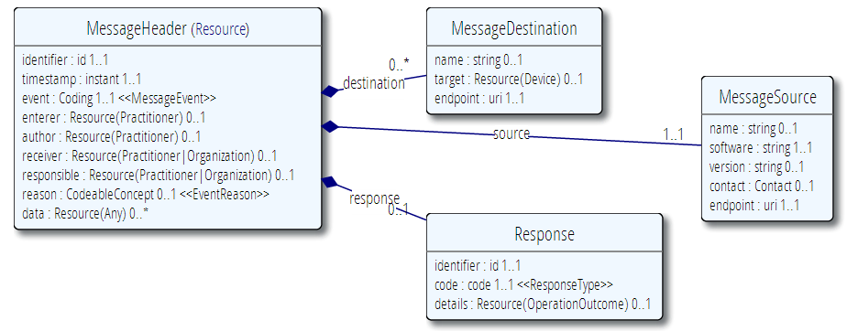
MessageHeader Resource

Slide 97
FHIR messages
No storage of the “MessageHeader” resource implied. Might be used in a router, converted to v2, etc.
The server can process messages based on the event code and return the response as another message (again a bundle).
Notes:
* It’s the same drop-off point as for documents!

Slide 98
Communicating messages
No REST necessary, you can send FHIR Messages over mail, MLLP, TCP, or even REST ;-)
FHIR defines an operation for message processing - $process-message
Response content type returned is always a Bundle with type "message"

Slide 99
Querying FHIR
Searches, Queries, Compartments & Validation

Slide 100
Getting “all” patients
https://server.org/fhir/Patient
Always returns a paged Bundle
Use _count to indicate number of results per page
Special case of the “real” search operation: https://server.org/fhir/Patient?name=eve

Slide 101
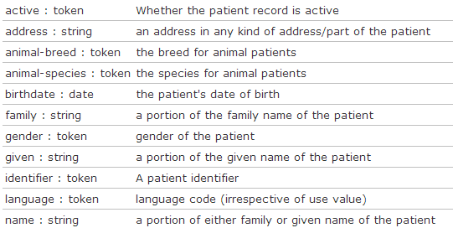
Search (patient)
Each resource has a set of “standard” search operations, so not every element can be searched (by default)!:
Our last search used this one

Slide 102
Combining parameters
Specifying multiple parameters finds resources matching all params ➔ “AND”
Parameters may list multiple values ➔ “OR”
Try:
https://server.org/fhir/Patient? birthdate=1972-11-30&language=nl,fr

Slide 103
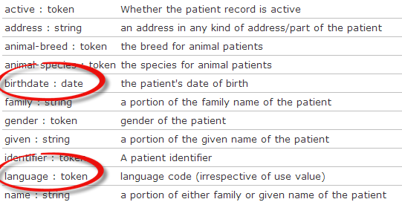
Search (patient)
Each search parameter has a ‘type’
Parameter
Type

Slide 104
Parameter types
number: =, =lt, =ge, =lt, =ge, =ne
Significant digits matter
date: =, =lt, =ge, =lt, =ge, =ne
Matches calculated using interval operations
Precision turns all dates into intervals
string: =
“starts-with” search, ignoring case, accents
Can use :contains for contains search or :exact to be case and accent-sensitive

Slide 105
Parameter types (cont’d)
token: =
[code] matches codes/identifier values independent of system
[system]|[code/value] matches a specified code or identifier within the specified system
|[code/value] matches the specified code or identifier in instances where no system is declared
:text performs a string search on CodeableConcept.text, Coding.display and Identifier.label
:in and :not-in allow filtering based on value sets

Slide 106
Parameter types (cont’d)
quantity: =, =lt, =gt, =le, =ge, =ne
[comparator][number]|[system]|[code]
Follows rules for number + token together for value + units of quantity
reference: =
Either the local or absolute id
:type filters resource type

Slide 107
Ok I get it…or not?
[base]/Patient 406 hits
[base]/Patient?gender=male 231 hits
[base]/Patient?gender=female 166 hits
[base]/Patient?gender=other 4 hits
[base]/Patient?gender=unknown 1 hits
Total: 231 + 166 + 4 + 1 = 402
[base]/Patient?gender:missing=true 4 hits
Total: 402 + 4 = 406

Slide 108
Chained searches
Patient has a search for “name”.
Observation has a search for “subject” (the id of the Patient, Group or Device)
How do I find Observations for a patient, searching using his name?

Slide 109
2 queries in 1
You (as a client) don’t need to do separate operations, just one:
https://server.com/fhir/Observation? subject.name=jim
But note: this still only works on the predefined search parameters. You cannot just use any property of the resource.
Notes:
You can chain multiple levels deep – 2, 3, 4, more levels deep
This would search subject on any (Patient, Device, Group, Location).
If you want to limit to patient you can do an &subject:type=Patient

Slide 110
More optimizations
Say we do:
https://fhir.com/fhir/Observation?date=2014-01-20
We get back: a Bundle with 0..* “Observations”
Now, usually, wouldn’t we want the Patient information too? => Need to do “N” queries for the Observation’s “subject”
Quicker:
?_include=Observation.subject
Returns both Observations + Patients

Slide 111
Reverse Include
You can also do the reverse. E.g. Give me this patient and all the observations that point to them (careful – this could be a large set . . .)
Patient?_revinclude=Observation:subject

Slide 112
Composites
What if I want to find all groups with a characteristic of “eye color = green”
Group?characteristic=eye color&value=green
Result: instance with characteristics of “eye color=blue” and “favorite color=green”
Solution
Group:characteristic-value=eye color$green
(don’t forget to escape the blank . . .)
Notes:
Obviously not real codes

Slide 113
Extension parameters
Just as FHIR doesn’t define all possible data elements, we don’t all possible parameters
Extension search parameters defined using Profiles
Conformance Statements identify what extension parameters are supported and what they’re called

Slide 114
Sorting
Use _sort: to control sort
E.g. Observation?_sort:name,-date
Sorts observations of the same type together, newest first
Notes:
Search results are in no particular order unless you provide a sort order

Slide 115

Paging
RFC 5005 defines a mechanism for paging a feed - we continue use it in Bundle
Keep in mind that paging can be tricky in a stateless environment
Result set can change
Don’t want to accidentally miss data when paging forward
Notes:
Consider adding a “most recent change timestamp” as part of the continuation so you can flag if changes impact result sets.
--
REST is stateless so folks could be adding and deleting data after your query. You could query and create a cached result set.
No predefined patterned for Continouation links – could be just GUIDs

Slide 116
Summary
Some resources can be “big”
e.g. Patient with pictures & lots of contacts
10MB JSON result set is bad when you’re an Android app presenting a list of 100 patients for a clinician to scroll through
Solution: _summary=true strips a resource’s elements down to those most likely to be useful in a “list” view.
Notes:
FHIR spec defines summary – not a server specific option

Slide 117
Compartments
Some system designs like to enforce security based on URL. For them
https://example.org/fhir/Patient/1/Observation
Is more useful than
https://example/fhir/Observation?subject=Patient/1
For that reason, FHIR allows Compartmenting by Patient, Practitioner, Organization and a few other resources where that is appropriate
Notes:
not strong use right now

Slide 118
Query by Tag
FHIR provides the ability to tag resources to identify profiles, access constraints, workflow, etc.
(We’ll discuss this more later)
In addition to normal query parameters, it’s also possible to query by tags applied to the resource
Notes:
Pull by profile or security label of something.

Slide 119
Get vs. Post
Query parameters can be sent either as part of the URL using a GET or as an application/x-www-form-urlencoded payload on a post
Some technologies may prefer one over the other. As well, POST hides query parameters from URL logging, which may provide privacy protections in some environments.
Notes:
Some folks have expressed concern about putting all the parameters in the URL. If you encrypt in TLS everything outside the port is secure, both the url and body. FHIR permits ability to put search parameters in the body.

Slide 120
Query interoperability
FHIR has a lot of query capability
However . . .
Almost all of it is optional
So how do you design a client when you have no clue what the server will support?
The more generic you want your client to be, the less you should rely on sophisticated server capabilities
Always check the response to see what parameters were actually used
Notes:
No server has support paging, chaining, filtering, etc. ALL OPTIONAL.
You could query for all and then process on client side, but that will let you interop with lots of folks, but be complex on client size and waste bandwidth since more is sent then needed. A client can determine what a server supports by using conformance resource – which confirms they are capable of
noSQL repository may make your head hurt.

Slide 121
Exercise #5
Answer some questions . . .
(20 minutes)
Notes:
Pick a few different servers…

Slide 122
Answer FHIR questions
Summary of all male patients born between 1960 and 1980
All patients whose organization is Health Level Seven
Most recent weight measurement
Patient van de Heuvel’s glucose readings over 6.2 g/dL
All patients with a confirmed condition of Asthma
Average blood pressure over the past year for patient smith
Notes:
Todo: real queries

Slide 123
FHIR Implementation Supports

Slide 124
The spec itself
The spec contains:
Validated examples
Descriptions, usage notes, constraints
Guidance for using paradigms
Guidance for interoperating with v2/v3/CDA
Be aware that when navigating by links, you may miss important information
So:
Before raising a question, make sure you’ve double-checked the spec ☺

Slide 125
Resources for developers
Where to get support:
http://chat.fhir.org
Stack Overflow
FHIR List server
gForge Tracker (Change requests)
FAQs (members only)
Test servers
http://wiki.hl7.org?title=FHIR

Slide 126
Other tools
Profile editors
Forge, Trifolia, others?
Validators
Java, C#
Questionnaire, Code System and ValueSet editor
Draft
IG Publisher
FHIR Registry

Slide 127
Reference implementations
Contents
Model – classes generated from the spec
Parsers – Parsers generated from the spec
Serializers – Serializers generated from the spec
FhirClient
Validation (currently Java only)
Java – Everything on the downloads page
.NET – NuGet “FHIR”, or GitHub “fhir-net-api”

Slide 128
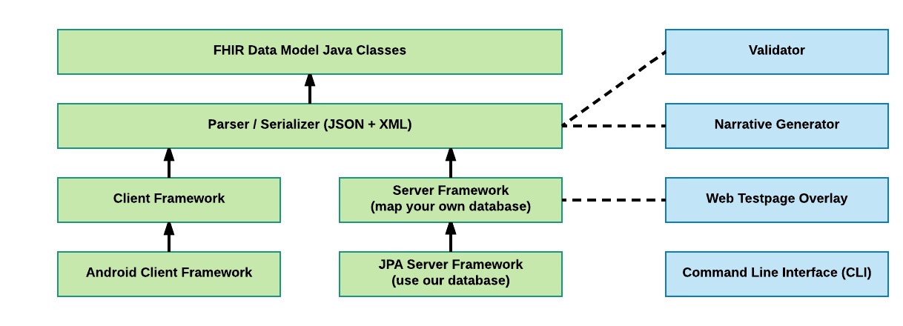
HAPI FHIR Modules
Components
Core Modules
Utilities

Slide 129
HAPI Versioning
HAPI version number != FHIR version number
HAPI FHIR version number != HAPI HL7v2 version number
 | FHIR DSTU1 | FHIR DSTU2 | FHIR R3 | FHIR R4
HAPI FHIR 1.0 | Yes | Draft
HAPI FHIR 2.0 | Yes | Yes | Draft
HAPI FHIR 2.5 | Yes | Yes | Yes
HAPI FHIR 3.0.0 |  | Yes | Yes | Draft
* Not all versions are shown here

Slide 130
The Context
The starting point for much of the HAPI-FHIR API is the FhirContext class
FhirContext acts as a factory for the rest of the API, including the two parsers:
XmlParser
JsonParser
FhirContext is designed to be created once and reused (important for performance!)

Slide 131
Encoding A Resource
public class Example04_EncodeResource {
public static void main(String[] theArgs) {
// Create a Patient
Patient pat = new Patient();
pat.addName().addFamily("Simpson").addGiven("Homer").addGiven("J");
pat.addIdentifier().setSystem("http://acme.org/MRNs").setValue("7000135");
pat.addTelecom().setUse(ContactPointUse.HOME).setSystem(ContactPointSystem.PHONE).setValue("1 (416) 340-4800");
pat.setGender(AdministrativeGender.MALE);
// Create a context
FhirContext ctx = FhirContext.forDstu3();
// Create a JSON parser
IParser parser = ctx.newJsonParser();
parser.setPrettyPrint(true);
String encode = parser.encodeResourceToString(pat);
System.out.println(encode);
}
}

Slide 132
Encoding A Resource
{
"resourceType": "Patient",
"identifier": [
{
"system": "http://acme.org/MRNs",
"value": "7000135"
}
],
"name": [
{
"family": "Simpson",
"given": [
"Homer",
"J"
]
}
],
"telecom": [
{
"system": "phone",
"value": "1 (416) 340-4800",
"use": "home"
}
],
"gender": "male"
}
public class Example04_EncodeResource {
public static void main(String[] theArgs) {
// Create a Patient
Patient pat = new Patient();
pat.addName().addFamily("Simpson").addGiven("Homer").addGiven("J");
pat.addIdentifier().setSystem("http://acme.org/MRNs").setValue("7000135");
pat.addTelecom().setUse(ContactPointUse.HOME).setSystem(ContactPointSystem.PHONE).setValue("1 (416) 340-4800");
pat.setGender(AdministrativeGender.MALE);
// Create a context
FhirContext ctx = FhirContext.forDstu3();
// Create a JSON parser
IParser parser = ctx.newJsonParser();
parser.setPrettyPrint(true);
String encode = parser.encodeResourceToString(pat);
System.out.println(encode);
}
}

Slide 133
Parsing A Resource
public class Example05_ParseResource {
public static void main(String[] theArgs) {
String resourceBody = "{\"resourceType\":\"Patient\",\"identifier\":[{\"system\":\"http://acme.org/MRNs\",\"value\":\"7000135\"}],\"name\":[{\"family\":[\"Simpson\"],\"given\":[\"Homer\",\"J\"]}]}";
// Create a context
FhirContext ctx = FhirContext.forDstu3();
// Create a JSON parser
IParser parser = ctx.newJsonParser();
Patient pat = parser.parseResource(Patient.class, resourceBody);
List<Identifier> identifiers = pat.getIdentifier();
String idSystemString = identifiers.get(0).getSystem();
String idValueString = identifiers.get(0).getValue();
System.out.println(idSystemString + " " + idValueString);
}
}
http://acme.org/MRNs - 7000135

Slide 134
Clients:
Two Distinct Flavours in HAPI FHIR
Annotation Generic/Fluent
public interface SampleClient extends IRestfulClient {
@Create
MethodOutcome create(@ResourceParam Patient thePatient);
@Read
Patient read(@IdParam IdType theId);
}
MethodOutcome outcome = client
.create()
.resource(pat)
.execute();
You create an annotated interface for your specific needs
Similar to JAX-RS or Spring REST (but does not use these frameworks)
Use chained method calls to do anything you need
This is generally easier and more popular

Slide 135
Clients:
Two Distinct Flavours in HAPI FHIR
Annotation Generic/Fluent
public interface SampleClient extends IRestfulClient {
@Create
MethodOutcome create(@ResourceParam Patient thePatient);
@Read
Patient read(@IdParam IdType theId);
}
MethodOutcome outcome = client
.create()
.resource(pat)
.execute();
Docs:
http://hapifhir.io/ doc_rest_client_annotation.html
Docs:
http://hapifhir.io/doc_rest_client.html

Slide 136
Create a Patient
public class Example06_ClientCreate {
public static void main(String[] theArgs) {
Patient pat = new Patient();
pat.addName().setFamily("Simpson").addGiven("Homer").addGiven("J");
pat.addIdentifier().setSystem("http://acme.org/MRNs").setValue("7000135");
pat.setGender(AdministrativeGender.MALE);
// Create a context
FhirContext ctx = FhirContext.forDstu3();
// Create a client
String serverBaseUrl = "http://fhirtest.uhn.ca/baseDstu3";
IGenericClient client = ctx.newRestfulGenericClient(serverBaseUrl);
// Use the client to store a new resource instance
MethodOutcome outcome = client
.create()
.resource(pat)
.execute();
// Print the ID of the newly created resource
System.out.println(outcome.getId());
}
}

Slide 137
Update a Patient
public class Example07_ClientReadAndUpdate {
public static void main(String[] theArgs) {
// Create a client
String serverBaseUrl = "http://fhirtest.uhn.ca/baseDstu3";
FhirContext ctx = FhirContext.forDstu3();
IGenericClient client = ctx.newRestfulGenericClient(serverBaseUrl);
// Use the client to read back the new instance using the ID we retrieved from the read
Patient patient = client
.read()
.resource(Patient.class)
.withId("example")
.execute();
// Print the ID of the newly created resource
System.out.println("Found ID: " + patient.getId());
// Change the gender
patient.setGender(patient.getGender() == AdministrativeGender.MALE ? AdministrativeGender.FEMALE : AdministrativeGender.MALE);
// Update the patient
MethodOutcome outcome = client
.update()
.resource(patient)
.execute();
System.out.println("Now have ID: " + outcome.getId());
}
}

Slide 138
Searching
public class Example08_ClientSearch {
public static void main(String[] theArgs) {
FhirContext ctx = FhirContext.forDstu3();
IGenericClient client = ctx.newRestfulGenericClient("http://fhirtest.uhn.ca/baseDstu3");
// Build a search and execute it
Bundle response = client.search()
.forResource(Patient.class)
.where(Patient.NAME.matches().value("Test"))
.and(Patient.BIRTHDATE.before().day("2014-01-01"))
.count(100)
.returnBundle(Bundle.class)
.execute();
// How many resources did we find?
System.out.println("Responses: " + response.getTotal());
// Print the ID of the first one
System.out.println("First response ID: " + response.getEntry().get(0).getResource().getId());
}
}

Slide 139
Other Operations
Lots of other FHIR operations are supported in the client:
History, CapabilityStatement, Transactions, Delete, etc.
There is also lots of support for advanced features:
Version aware updates, Get-if-newer, etc.
Reminder about docs:
http://hapifhir.io/doc_rest_client.html

Slide 140
Client Interceptors
Interceptors “wrap” each client operation and can:
Examine outgoing requests before they happen
Change outgoing requests before they happen
Examine incoming responses after they happen
Interceptors implement the IClientInterceptor interface

Slide 141
Built-In Interceptors
http://hapifhir.io/doc_rest_client_interceptor.html
BasicAuthInterceptor and BearerTokenAuthInterceptor
Add credentials to request
LoggingInterceptor
Log what the client is doing
CapturingInterceptor
Retain the request and response after the call completes

Slide 142
Server Architecture
HAPI FHIR provides a REST Server framework
Based on standard JEE/Servlet 2.5+ (Tomcat, Glassfish, Websphere, JBoss, etc)
Inspired by (but not based on) JAX-RS, RestEasy, Spring REST, etc.
* A JAX-RS HAPI module is available but it is not covered here

Slide 143
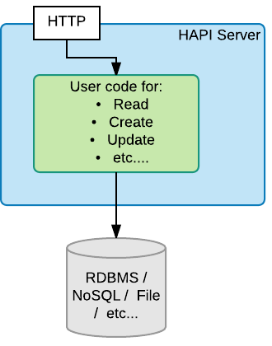
Server Architecture (2)
You supply Java code for CRUD operations you want to support in your server
Read
Create
Update
Delete
Search
etc…

Slide 144
Server Architecture (3)
HAPI FHIR will:
Handle parsing and encoding
Route URLs, Verbs, and parameters to appropriate methods
Understand FHIR escaping rules

Slide 145



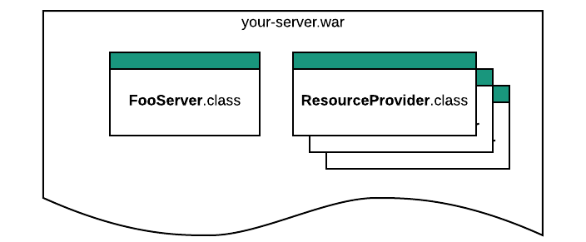
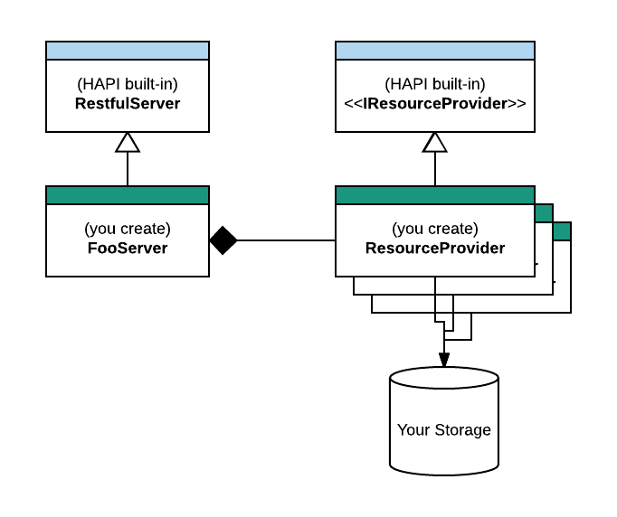
Server Architecture (3)
Your code can be deployed in a Java Servlet Container

Slide 146
JPA Server Framework
HAPI JPA Server is a complete server implementation from the database schema up
It includes:
All standard REST verbs (create, read, update, delete)
Many fancy REST features (ETag, conditional, patch, etc.)
Extensive search support including custom parameters
Terminology services
Subscription services
Many configurable settings

Slide 147
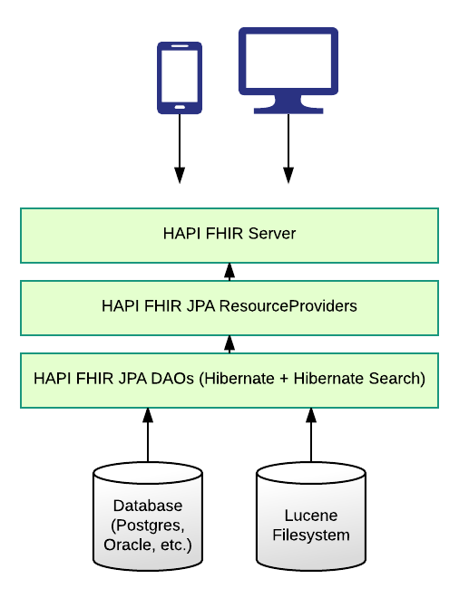
JPA Architecture
The same server from the previous section
Generated ResourceProviders for all resource types
Implementation of most operations, search types, terminology svc, etc.
Database of your choosing

Slide 148
JPA Architecture
The JPA Server uses Hibernate, which means it supports several RDBMS platforms:
Oracle, Postgres, MySQL, SQL Server
Most examples use Derby
Derby is great for testing, but it not a production option!

Slide 149
Lucene
HAPI uses Apache Lucene to provide two features:
Fulltext searching within resources (_text and _content parameters)
Terminology Services
Lucene stores its files on the filesystem
Lucene can be safely disabled

Slide 150
Extensions: The Easy Way
public class Example30_AddSomeExtensions {
public static void main(String[] theArgs) {
Patient pat = new Patient();
pat.addName().setFamily("Simpson").addGiven("Homer").addGiven("J");
// Add an extension on the resource
pat.addExtension()
.setUrl("http://hl7.org/fhir/StructureDefinition/patient-importance")
.setValue(new CodeableConcept().setText("Patient is a VIP"));
// Add an extension on a primitive
pat.getBirthDateElement().setValueAsString("1955-02-22");
pat.getBirthDateElement().addExtension()
.setUrl("http://hl7.org/fhir/StructureDefinition/patient-birthTime")
.setValue(new TimeType("23:30"));
IParser parser = FhirContext.forDstu3().newJsonParser().setPrettyPrint(true);
System.out.println(parser.encodeResourceToString(pat));
}
}

Slide 151
When and how to Validate
There is no right answer to this question!
Validate strictly during development but be loose in production? Always be strict?
Validate some resource types but not others?
Validate on the way in but not the way out?
Structural vs semantic validation? (there is a performance cost!)

Slide 152
Validation in HAPI FHIR
Validator
(semantic validation)
Applies a complete set of rules to a resource instance
Currently far more powerful
Parser Error Handler
(structural validation only)
Parser can be configured with an “Error Handler” which logs or fails on error
Only catches structural issues

Slide 153
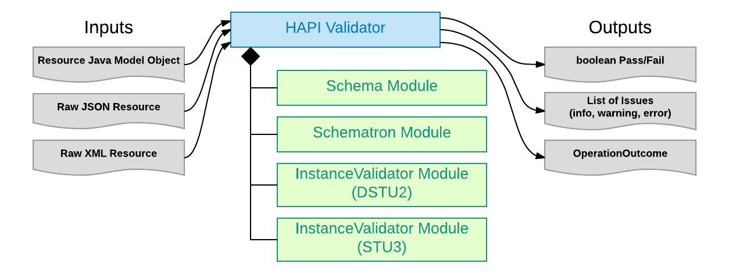
Validator
HAPI’s validator uses modules and collects the results from any that are enabled
Create your own if you want!

Slide 154
Schema/Schematron Validator
FHIR provides schemas + schematrons for validating conformance to basic resource requirements:
Cardinality
Optionality
Required bindings
Datatype rules
The Schema + Schematron modules are the defaults if nothing else is selected

Slide 155
Using the Schema Validator
public class Example20_ValidateResource {
public static void main(String[] args) {
// Create an incomplete encounter (status is required)
Encounter enc = new Encounter();
enc.addIdentifier().setSystem("http://acme.org/encNums").setValue("12345");
// Create a new validator
FhirContext ctx = FhirContext.forDstu3();
FhirValidator validator = ctx.newValidator();
// Did we succeed?
ValidationResult result = validator.validateWithResult(enc);
System.out.println("Success: " + result.isSuccessful());
// What was the result
OperationOutcome outcome = (OperationOutcome) result.toOperationOutcome();
IParser parser = ctx.newXmlParser().setPrettyPrint(true);
System.out.println(parser.encodeResourceToString(outcome));
}
}

Slide 156
Using the Schema Validator
<OperationOutcome xmlns="http://hl7.org/fhir">
<issue>
<severity value="error"/>
<code value="processing"/>
<diagnostics value="cvc-complex-type.2.4.b: The content of element 'Encounter' is not complete. One of '{&quot;http://hl7.org/fhir&quot;:identifier, &quot;http://hl7.org/fhir&quot;:status}' is expected."/>
<location value="Line[1] Col[140]"/>
</issue>
</OperationOutcome>
public class Example20_ValidateResource {
public static void main(String[] args) {
// Create an incomplete encounter (status is required)
Encounter enc = new Encounter();
enc.addIdentifier().setSystem("http://acme.org/encNums").setValue("12345");
// Create a new validator
FhirContext ctx = FhirContext.forDstu3();
FhirValidator validator = ctx.newValidator();
// Did we succeed?
ValidationResult result = validator.validateWithResult(enc);
System.out.println("Success: " + result.isSuccessful());
// What was the result
OperationOutcome outcome = (OperationOutcome) result.toOperationOutcome();
IParser parser = ctx.newXmlParser().setPrettyPrint(true);
System.out.println(parser.encodeResourceToString(outcome));
}
}
false

Slide 157
Get Help!
See our website for documentation: http://hapifhir.io
We also have a Google Group / Mailing List https://groups.google.com/d/forum/hapi-fhir
Zulip is great but less monitored by the HAPI FHIR team

Slide 158

Questions?
http://hl7.org/fhir lmckenzie@gevityinc.com
https://www.surveymonkey.com/r/YHYFFXD

